Slide 1

CONTEXTUAL CAMOUFLAGE
MCKOY CREATIVE PRESENTS
INTERACTIVE • MULTIMEDIA • WEB APP • PROJECTION • POP-UP INSTALLATION

Slide 2
INNOVATE → CREATE: CREATIVITY CONSULTING
WHAT IS MCKOY CREATIVE?
McKoy Creative uses art, design, and multimedia to help increase outreach, engage communities, and deliver unique products & services.
We work non-profit, for-purpose, and community based organizations develop and implement marketing strategies with social impact.

Slide 3
PROBLEM: MENTAL HEALTH RESEARCH AND RESOURCES NOT REACHING COMMUNITIES, FURTHERING STIGMA AROUND MENTAL DISORDERS
THE CHALLENGE
Discoveries can take up to 17 years to reach communities
Most research is disseminated through hard to obtain and difficult to understand academic journals or industry conferences, especially for the layperson
The presentation of research tends to have a pragmatic approach that fails to engage and activate communities in a meaningful way

Slide 4
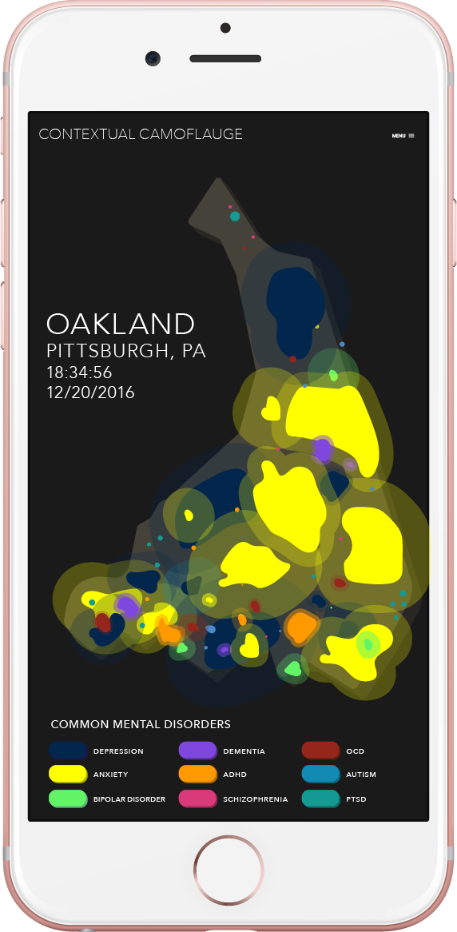
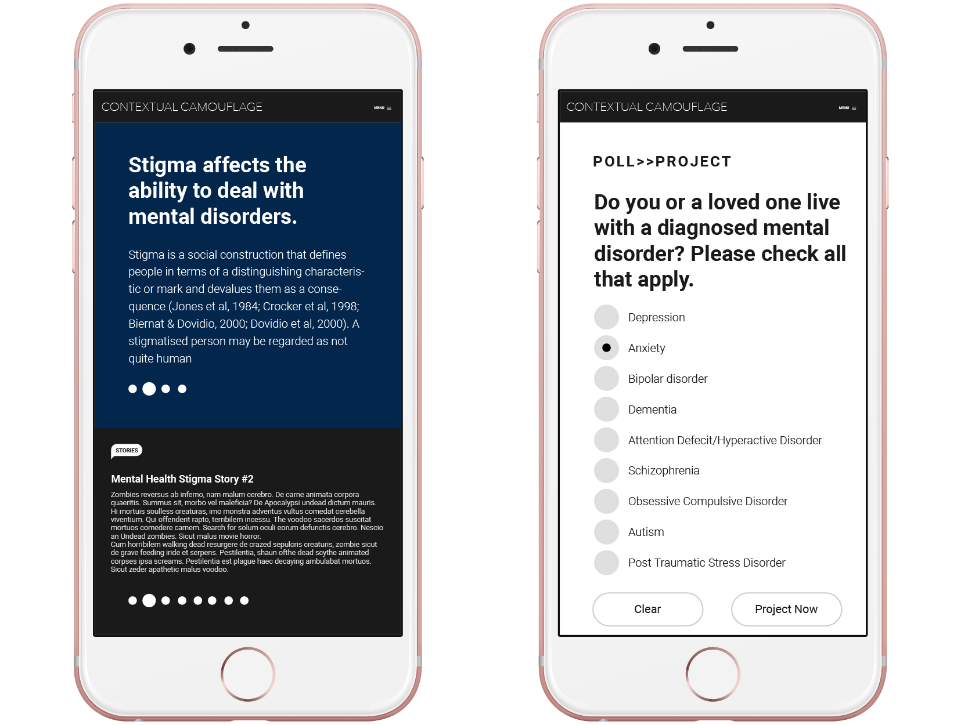
SOLUTION: CONTEXTUAL CAMOUFLAGE
THE CHALLENGE
A [web] app that uses geographic information systems (GIS) to gather mental health data anonymously based on user input and present it in real time via a heat map.
The [web] app will also provide resources and present current research.
Users can opt-in to have their (non-)personal data used in research
There will also be a public installation of the heat map projected at target location(s).

Slide 5
STRATEGY
Having the community interact by posting their own mental disorder experience to the heat map increases community buy-in and engagement.
Researchers, caregivers, therapists, and mental & behavioral health professionals can use the data presented to better create targeted programming and marketing, as well as identify potential triggers and issues
Notes:
Having the community interact. . .
The project will show that anyone, could be living with a mental disorder and you wouldn’t even know it, also showing those that live with mental disorders they are not alone.

Slide 6
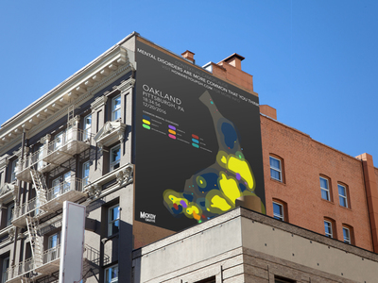
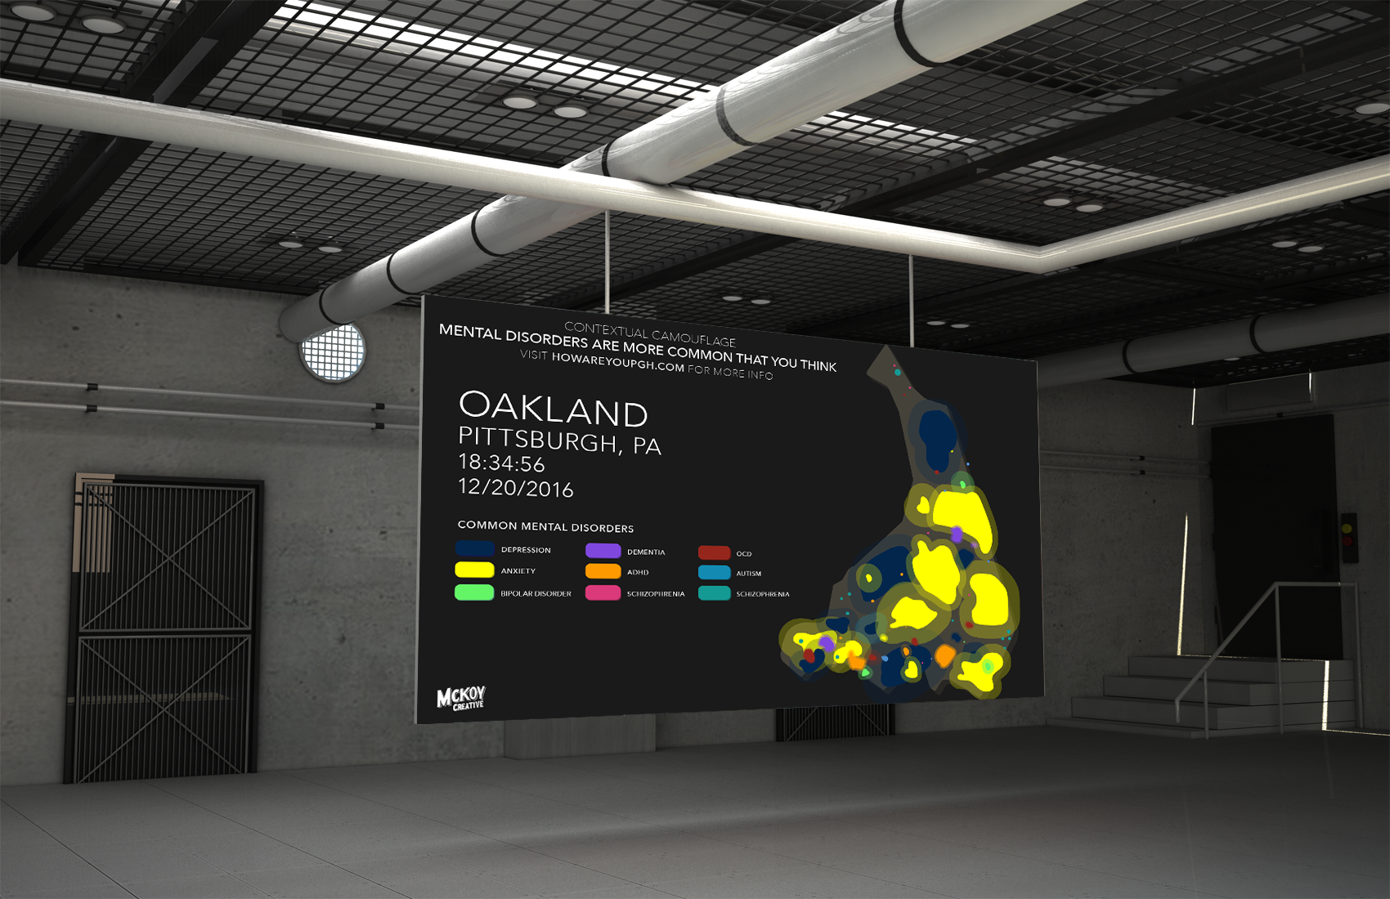
CONTEXTUAL CAMOUFLAGE TRANSFORMING RESEARCH INTO A LIVING NARRATIVE
OUTCOMES
By popping up at a minimum of 3 locations in any proposed area in tandem with the app, we hope to:
INCREASE AWARENESS
COMBAT STIGMA
CONNECT COMMUNITY
Notes:
INCREASE AWARENESS : With a population of approx. 7333 people, at a median age of 23 we aim to get a min. of 20% of residents to the website (approx. 1500 people)
COMBAT STIGMA : Decreasing stigma of behavioral health and those living with mental disorders using information coupled with compassion
CONNECT COMMUNITY : Provide an outlet for community to educate themselves on behavioral health issues and resources to care providers and specialists

Slide 7
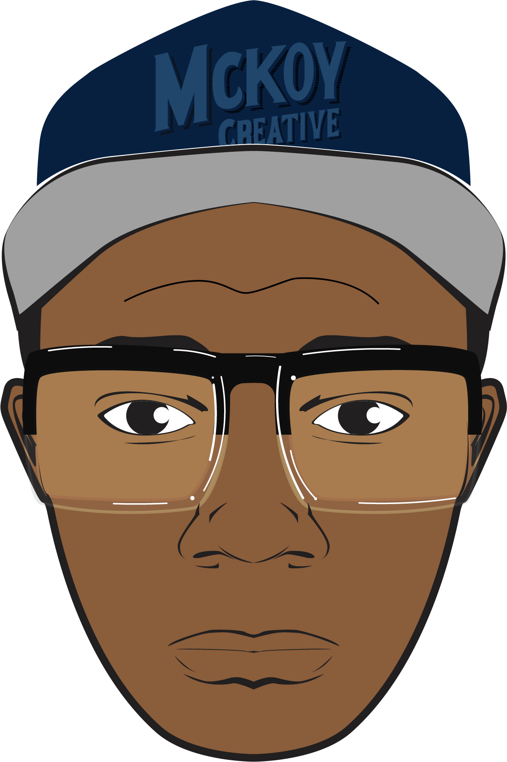
OUTCOMES
Ultimately, I want Contextual Camouflage to show that anyone, anywhere around you could be living with a mental disorder and you wouldn’t even know it, whilst also showing those that live with mental disorders that they are not alone.

